Slide 1
By:
Vincent van der Meer
Research Proposal
To maintain the ability to recover deleted files:
about the further development and future-proofing of this digital forensic specialization.
OU
February 2018

Slide 2
Agenda
Introduce myself
Short introduction in Digital Forensics
The story so far (my research progress)
What’s the plan?

Slide 3
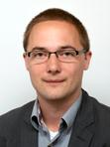
Visual resume
VINCENT
CONTACT INFORMATION
PROFESSIONAL SKILLS
VAN DER MEER
VINCENT.VANDERMEER@ZUYD.NL
06-43577395
ICT ARCHITECTURE
TRAINING
TOGAF
REQUIREMENTS ANALYSIS
TEACHING
PRINCE2
SOFTWARE DEVELOPMENT
ITIL
BUSINESS PROCES MODELLING
TMAP NEXT
ZUYD HOGESCHOOL
DOCENT
OPERATOR GROEP DELFT
TOPDESK
ALGEMENE PENSIOEN GROEP
APPLICATIEBEHEERDER
JAVA DEVELOPER
INFORMATIE ANALIST
ICT ARCHITECT
00
01
02
03
04
05
06
07
08
09
10
11
12
13
14
TECHNISCHE UNIVERSITEIT DELFT
CIBIT ACADEMY
COMPUTER SCIENCE
ICT ARCHITECTUUR

Slide 4
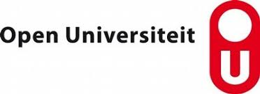
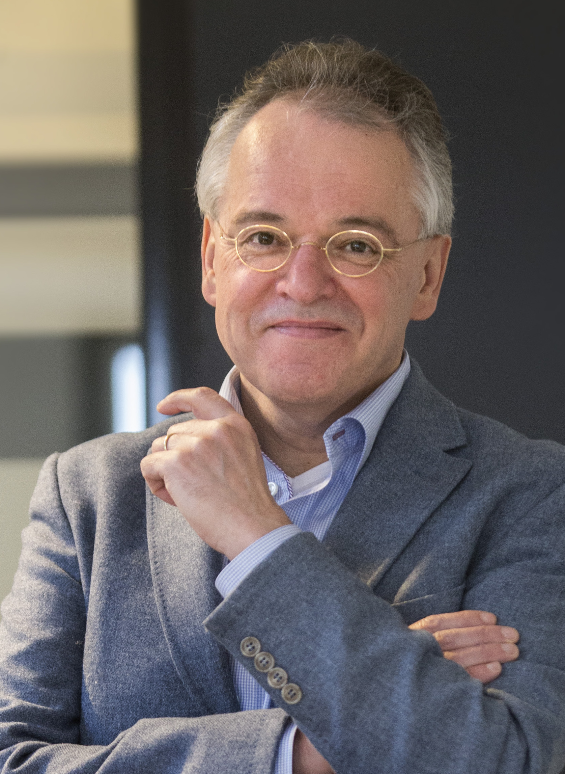
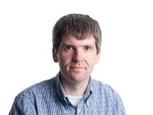
Stakeholders / research partners
Marko van Eekelen (Promotor)
Jeroen van den Bos (co-promotor)

Slide 5
Introduction Digital Forensics
Forensic Research:
“is the application of science to criminal and civil laws, during criminal investigation”
Digital Forensic Research:
See “Forensic Research”
Forensic Research where evidence of stored on a digital medium.
File Carving
“is the practice of searching an input for files or other kinds of objects based on content,
rather than on metadata”
Key Values
1) Objectivity
2) Evidence authenticity
3) Evidence integrity
4) Transparancy & reproducability
Notes:
Objectiviteit
Bewijs authenticiteit
Bewijs integriteit
Transparantie & reproduceerbaarheid

Slide 6
Data Recovery
Browser
00,“http://sci-spot.com”,47x,15022016
content
00546347287467359029398364538435
Serialized to file
Stored in file system
6483864528638475
0054634728746735
3428023573756437
9029398364538435
6483864564538435
9029398373756437
2874673534280235
2863847500546347
Mapped onto wear-leveled flash chip
Notes:
Verschillende browsers, browserversies, bestandsformaten en character encoding, bestandssystemen, en SSD controllers.
Vraag 1: waarom niet gewoon de inbeslaggenomen pc aanzetten en bestuderen?
Vraag 2: na het maken van een image, waarom niet een ‘windows verkenner’ openen en de inhoud bestuderen?
Afdalen naar het eerste hardware niveau, ‘consumenten’ kunnen dat meestal niet manipuleren.

Slide 7
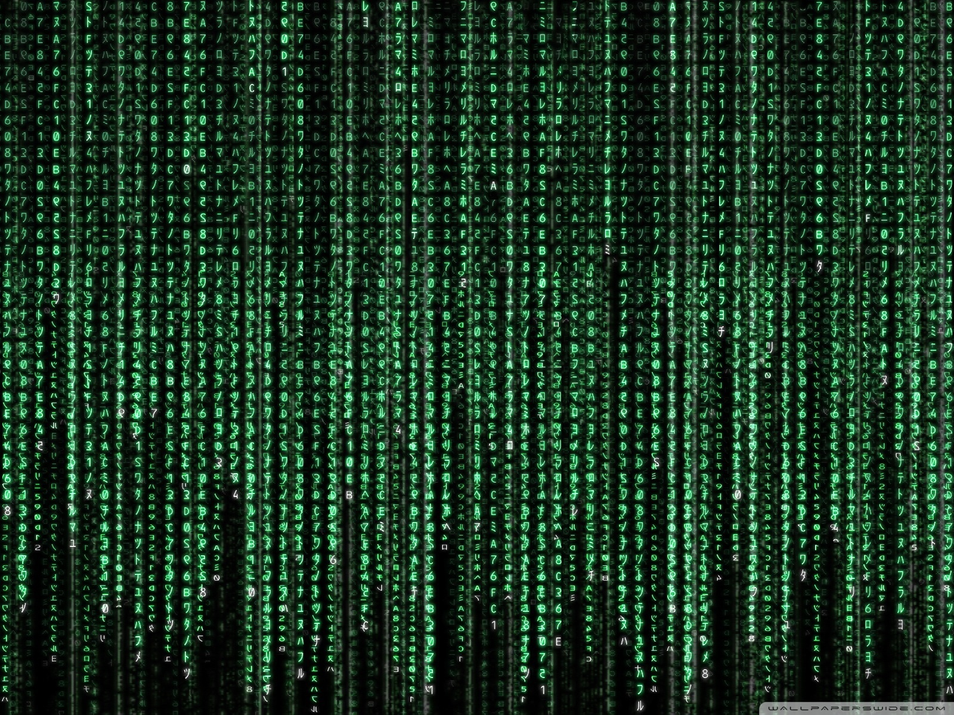

Slide 8
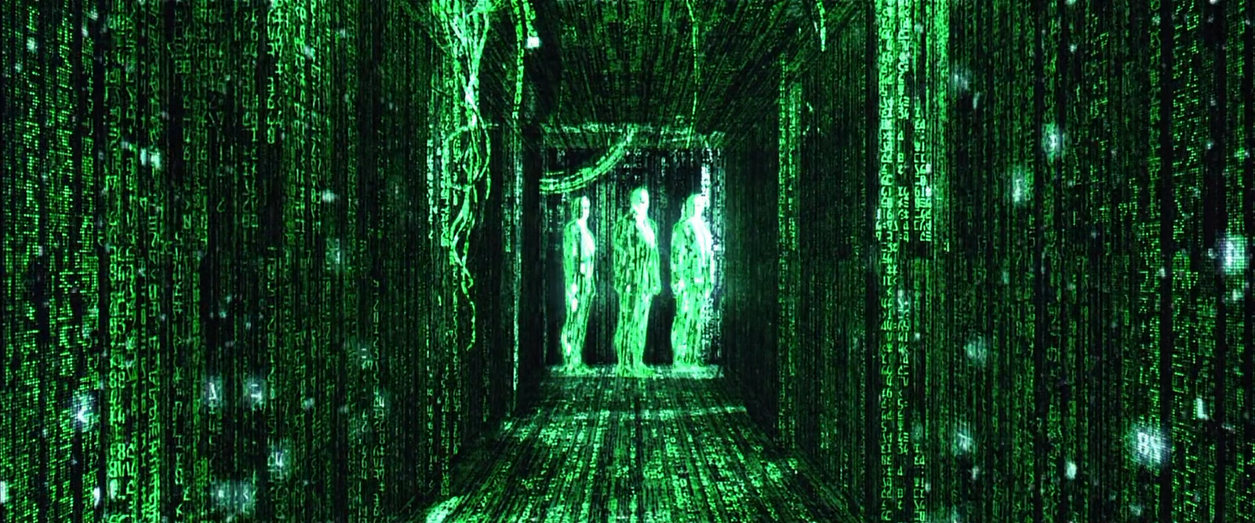

Slide 9
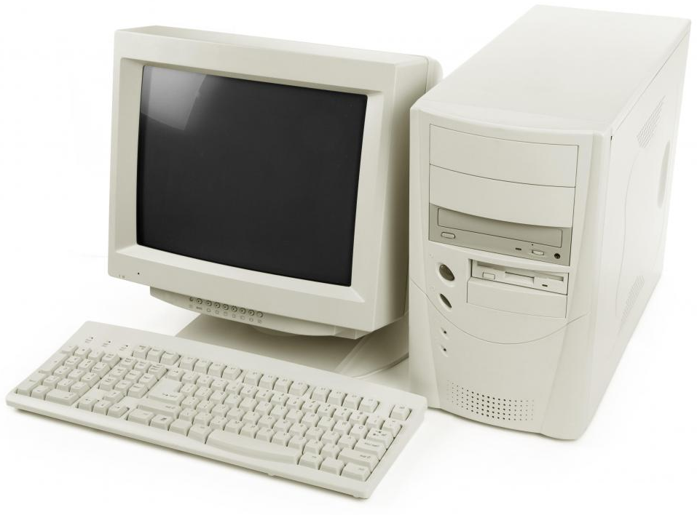
‘Golden Years’

Slide 10
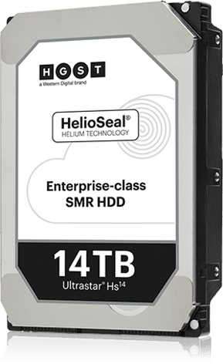
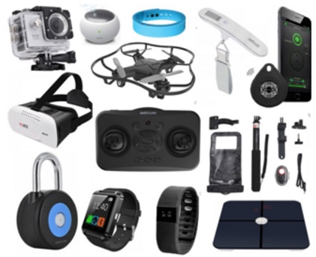
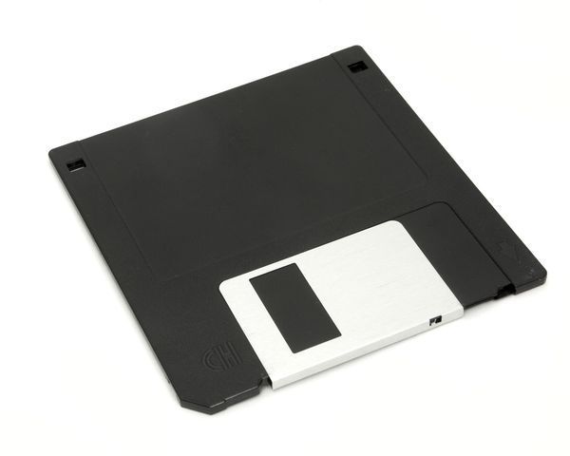
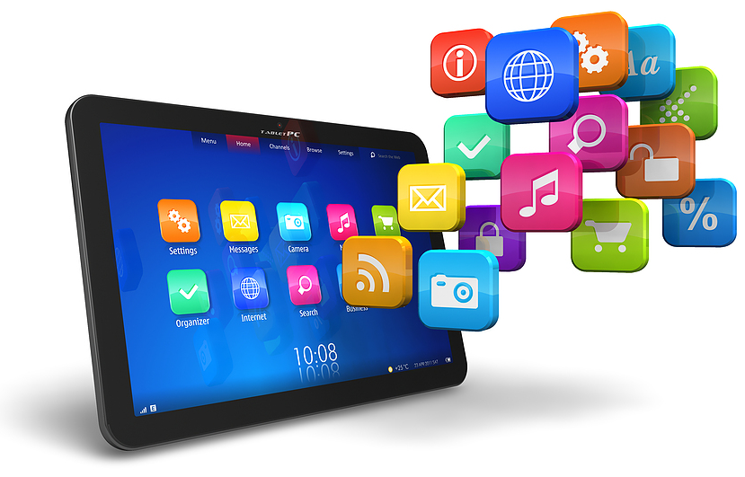
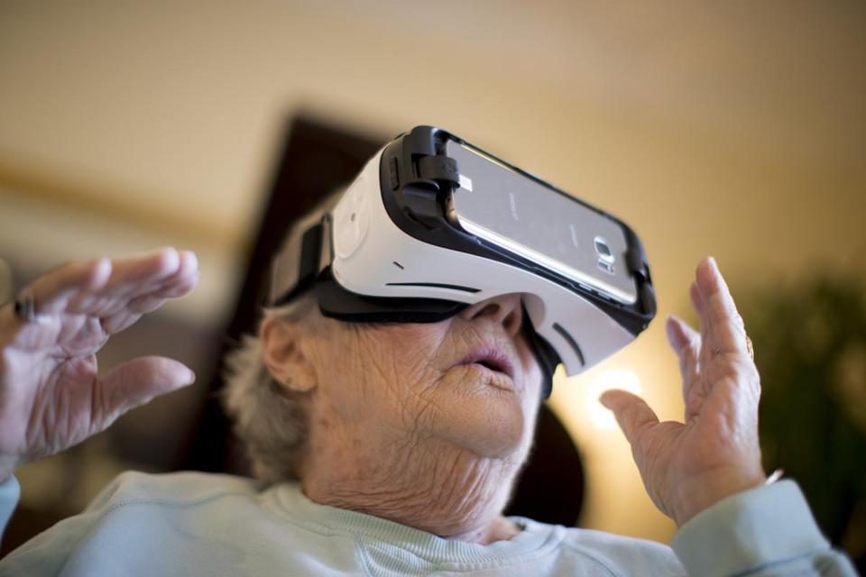
‘Era of Crisis’
x 10.000.000
Notes:
1) Opslag neemt exponentieel toe: 10 miljoen diskettes passen op 14 TB
2) Het aantal devices neemt toe
3) Het aantal toepassingen neemt toe
4) Het aantal gebruikers en gebruikersgroepen neemt toe

Slide 11
Evidence = knowledge AND data
knowledge
data
evidence
Notes:
In een viertal dimensies een groeiend probleem van data(acquisitie): hoe visualiseert zich dat?
Niet alle data is te achterhalen of te interpreteren: er bestaan sporen die niet gevonden worden.

Slide 12
Evidence = knowledge AND data
knowledge
data
evidence
Notes:
De groei is zo groot: groeit onze kennis mee, en de juiste richting op?

Slide 13
The story so far

Slide 14
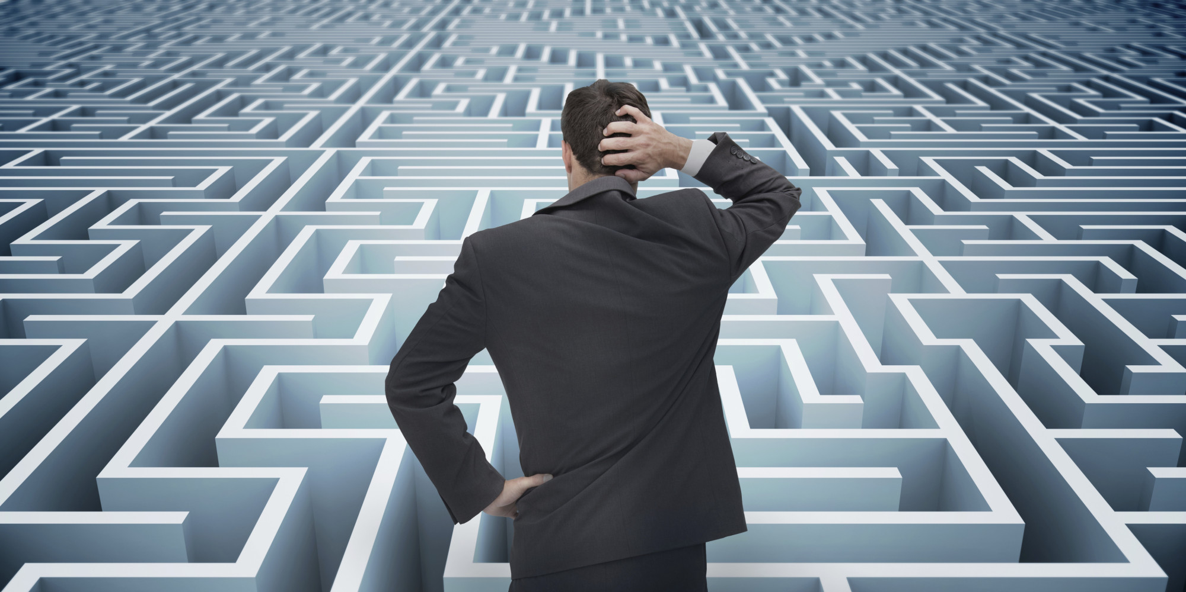
Organizational difficulties

Slide 15
I was given a green field approach…
Digital Forensic Research
Digital Forensic Process
Open Source
Forensic Tooling
Cloud Computing & Forensic Threats
Business & IT-alignment
Digital Forensics
as a Service
Forensic Datasets
…with a U-turn
File Carving

Slide 16
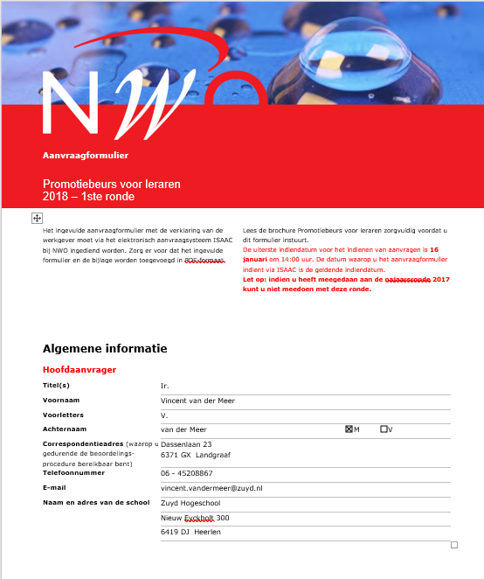
NWO – Doctoral Grant for Teachers

Slide 18
Research Questions
Main research question: How can we maintain the ability to recover deleted files?
Sub-research questions:
What are the biggest shortcomings and weaknesses in existing file-carving techniques, given the current and rapedly changing hardware- and software landscape?
How can existing file-carving techniques best be abstracted and generalized so that the quality, effectiveness, and extensibility of file-carving can be increased?
How can these carving-techniques and knowledge be made future proof, so that they can still be effective with future technology-changes?

Slide 19
First steps – Fuzzing jpg/png/gif libraries in search for new file formats
Goal: To discover new file formats variations.
File-carving algorithms can be made more future- proof with this knowledge.
How: Using a fuzzing library (American Fuzzy Lob) with popular graphical libraries, with a varying input (seeds)
Difficulties:
My first Linux desktop & CLI experience.
Runtime: approx 8 hours CPU time to recreate the basic experiment.
I don’t know if a new file-format variantion will be found.

Slide 20
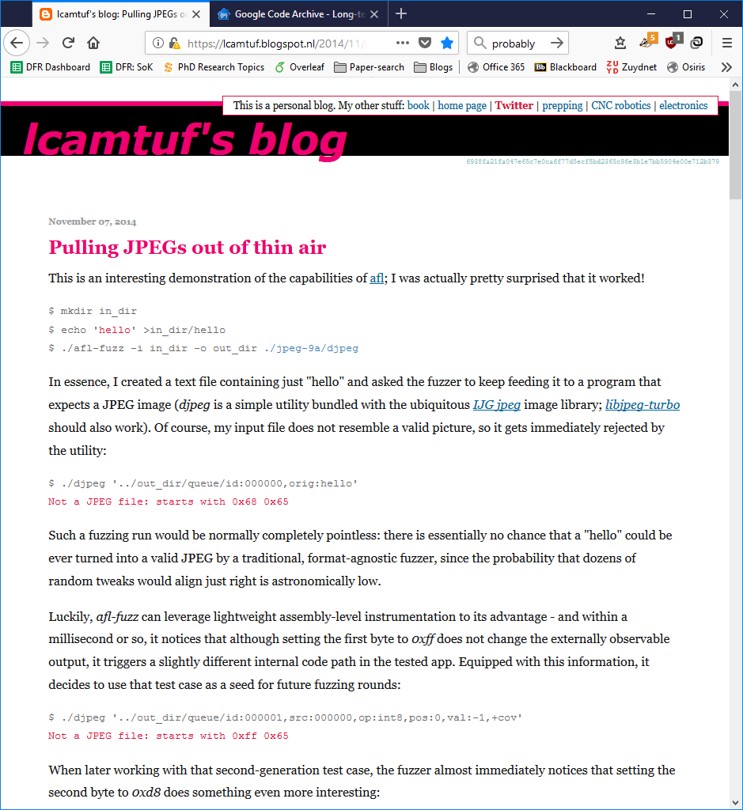
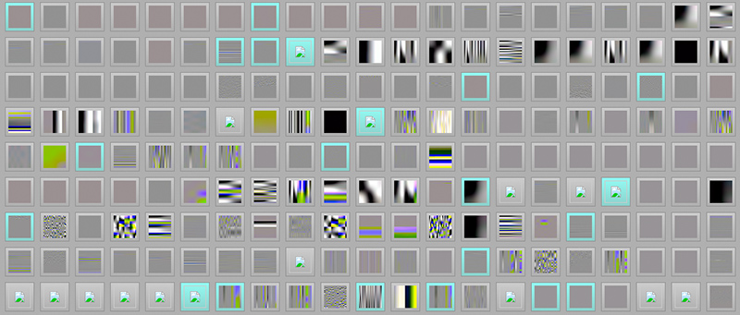
Inspired by
Input: hello.txt
Output:

Slide 21
First steps – Fragmentation in the Wild
Goal: Better understand fragmentation patterns, and to
use this knowledge to fine-tune carving algorithms.
How: Measure fragmentation on relevant device- categories. These can be: Windows laptops, Android phones, USB-drives or SD-cards.
Difficulties: Each platform has its own difficulties in performing a fragmentation analysis.
Availability (USB-drives, SD-Cards)
Low level measurements (Android) -> Emulators?
Windows (laptop) measurements probably have the least added value.

Slide 22
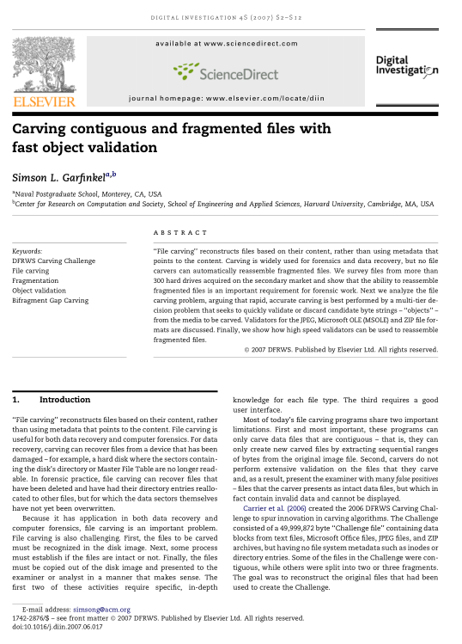
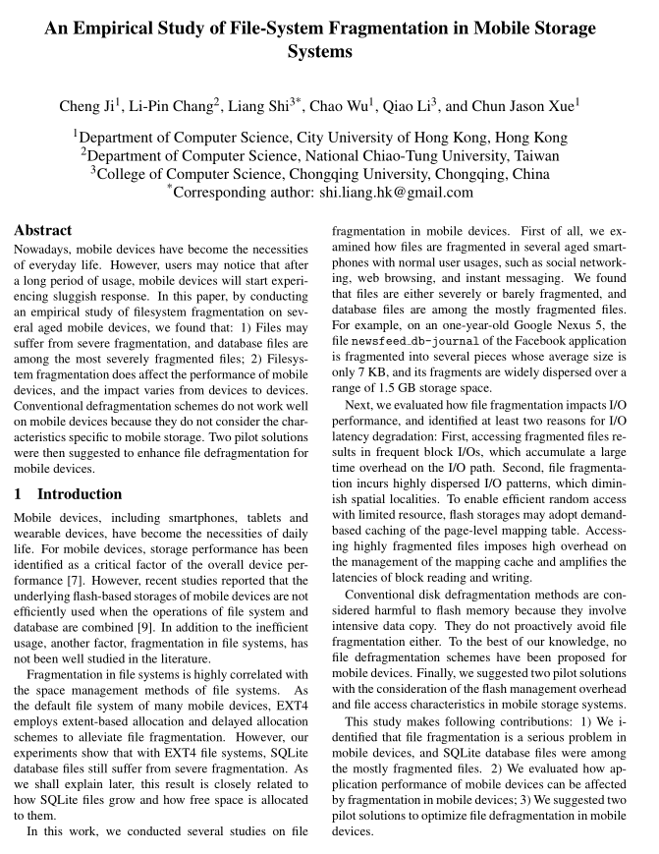
Inspired by

Slide 23
Thank you for you time & attention
And I love to hear your feedback, tips and questions!

